Slide 1

Improving Voter Turnout: A Data Science Approach to Examining Personal and Environmental Factors and their Relationship to Voter Participation
Team - Charlotte1
Sthanu Ramakrishnan, Jared Leach, Divya Garg, Marc Rizzo, Paul Blase
DSBA/MBAD-6211 : Advanced Business Analytics : Group Project

Slide 2

Introduction
Most elections are dominated by two main features:
Party preferences
Voter participation
Bipartisan stances seem steady
What prior information can provide better insight into voter participation?

Slide 3
Mission Statement
How do we predict high voter participation by region?
How does race factor into participation?
What impact does income/employment effect voting?
Do use of public aid and education predict voter activity?
Other factors? (age, crime, transportation availability, etc.)

Slide 4
Literature Review
‘Age’ variable in almost all the previous voter participation research.
Less people in age group (18-25) vote.
Race of potential voter and candidate. (Minority voters less likely to vote)

Slide 5
Literature Review
Less voter turnout when
Less Education / Less Income
Less healthcare area
Higher the crime rate area
Areas with poor road and public transport connection

Slide 6
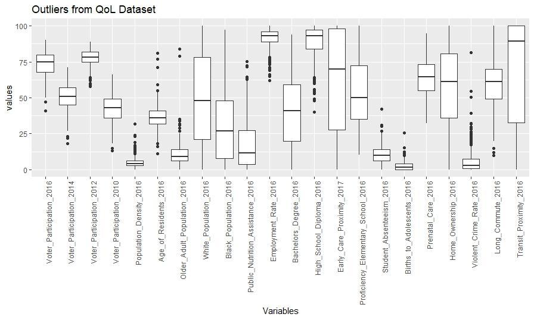
Data Manipulation

Slide 7
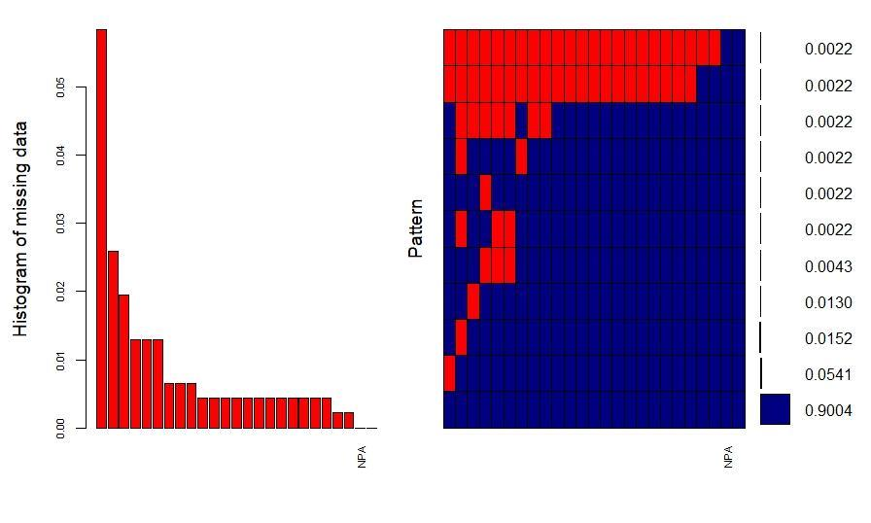
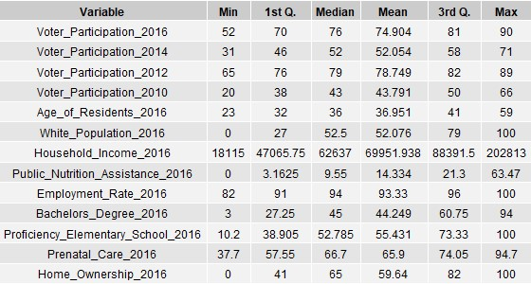
Data Manipulation- MICE
Initial:
462 observations, 24 features
Final:
406 observations, 13 features
12 imputed values

Slide 8
Methods
Cluster Analysis
Preliminary analysis on grouping of data
Hierarchical - Ward’s method
k-means
Evaluation : within-group SSE, Silhouette Coefficient, Hopkins Measure
Notes:
Cluster - this type of analysis will yield an initial look into the grouping of the data and make descriptive statements about differences

Slide 9
Methods
Random Forest
First Voter Turnout Classification Model
Evaluation : OOB Classification Error Rate, Accuracy
Ordinal Logit
Second Voter Turnout Classification Model
Cumulative link model (clm)
Notes:
Cluster - this type of analysis will yield an initial look into the grouping of the data and make descriptive statements about differences

Slide 10
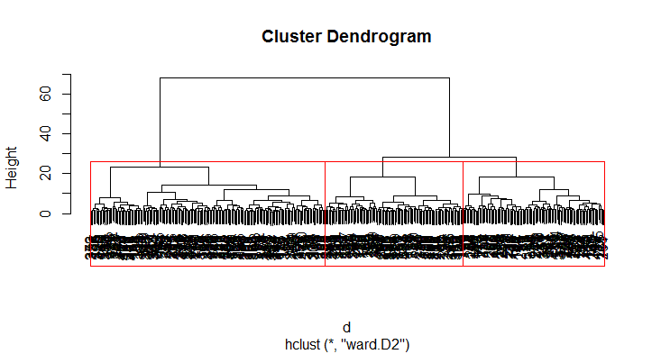
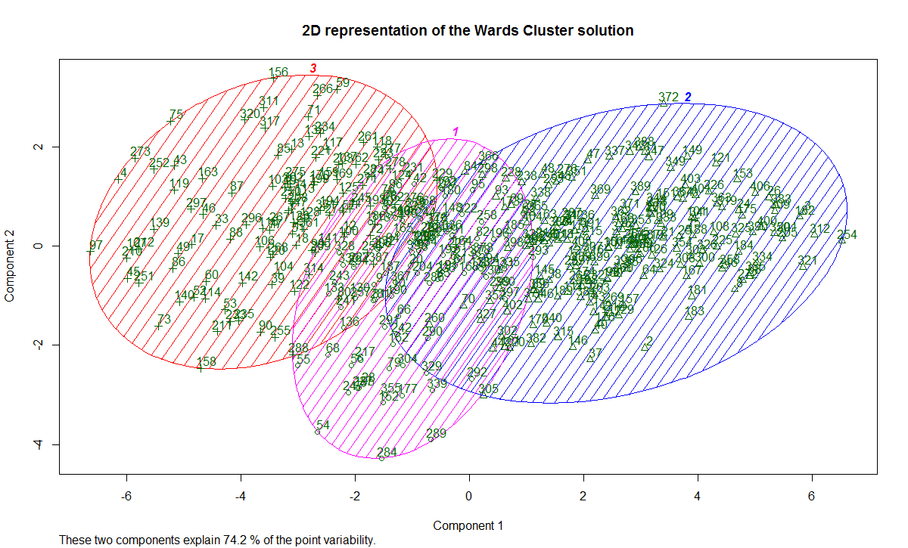
Clustering
Hopkins Value = 0.258
Ward’s method for hierarchical clustering

Slide 11
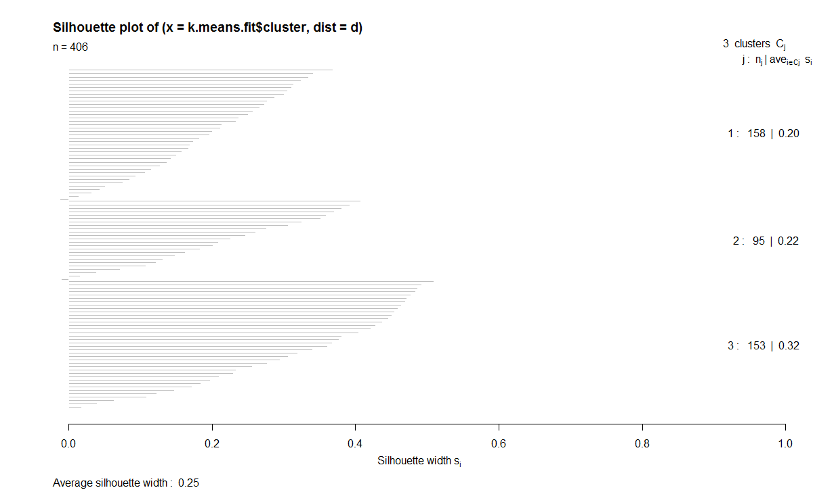
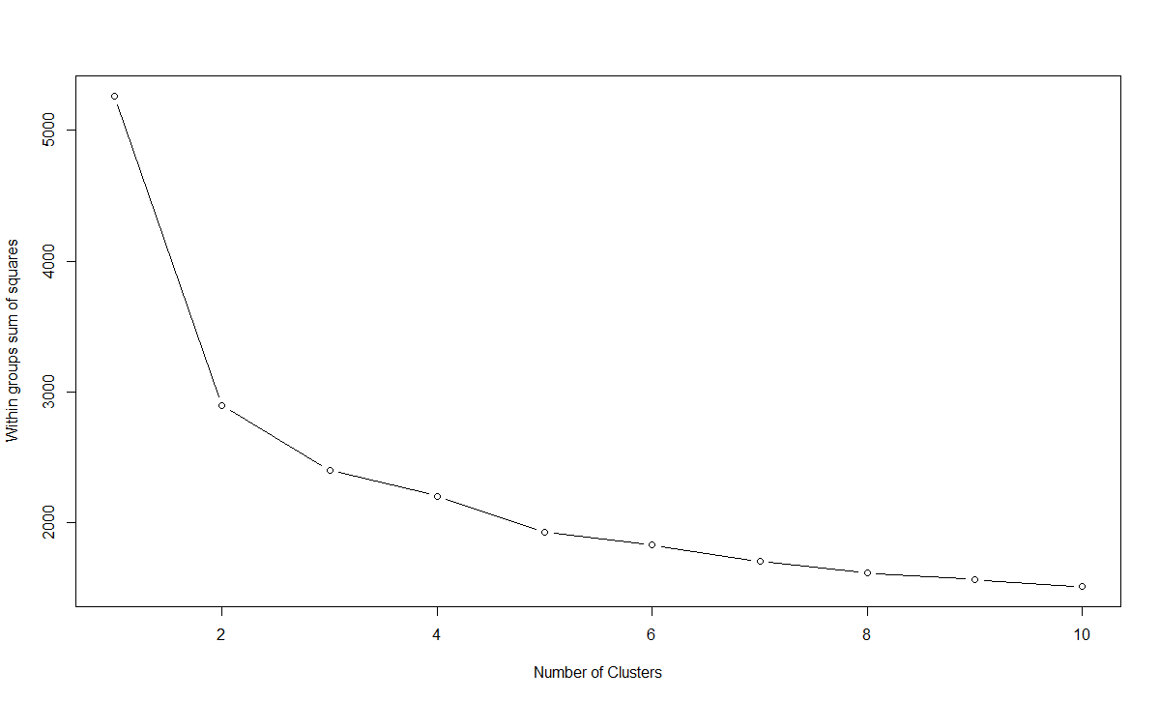
Clustering
K-Means Clustering
Average voting percentage in the 3 clusters : 82%, 74%, 66%

Slide 12
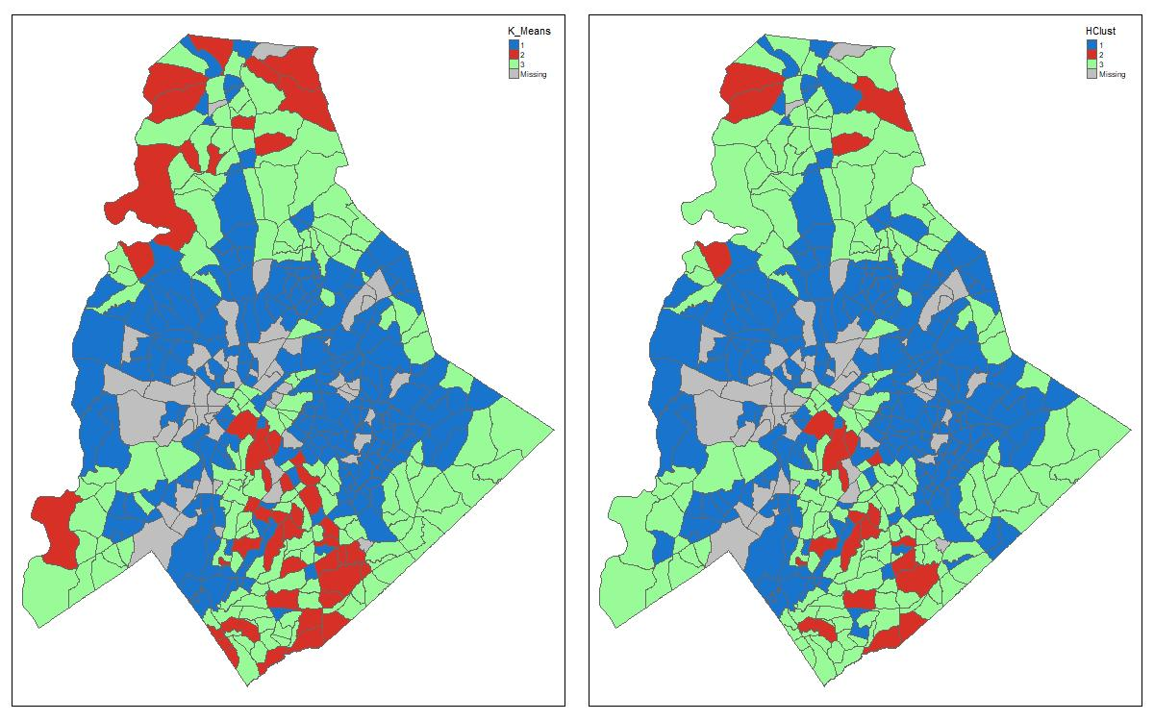
Clustering

Slide 13
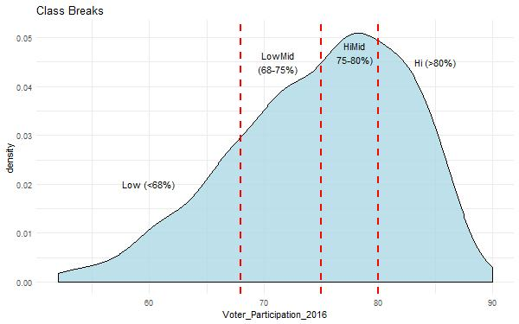
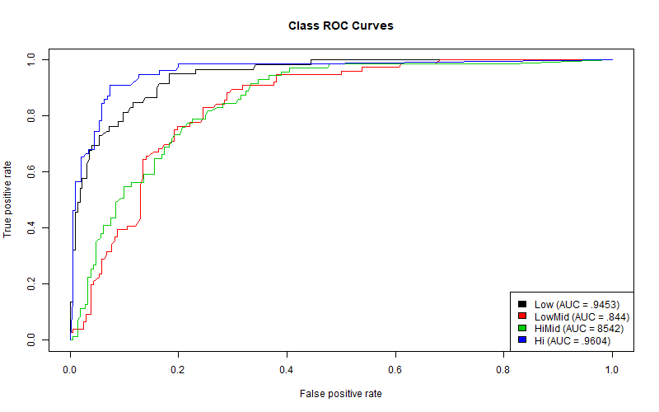
Random Forest
Assessed on Hi, HiMid, LowMid, Low classifications
Accuracy: .7131
Actual→ Predicted↓ | Low | LowMid | HiMid | Hi
Low | 18 | 1 | 0 | 0
LowMid | 7 | 25 | 6 | 0
HiMid | 0 | 7 | 21 | 7
Hi | 0 | 0 | 7 | 23

Slide 14
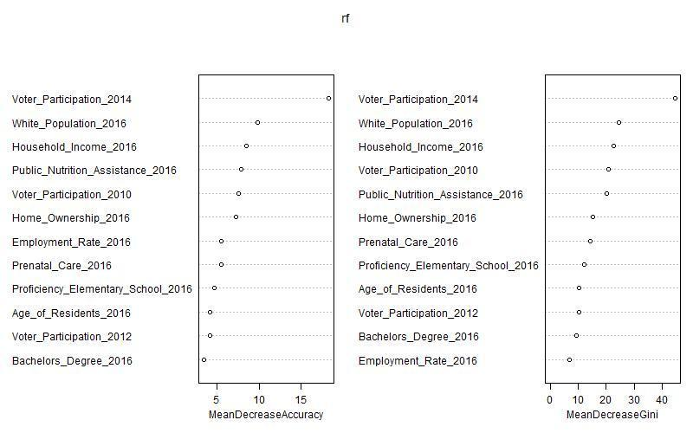
Random Forest
Past participation best indicator of future
Financial assets indicate higher participation
Education has limited effect on participation

Slide 15
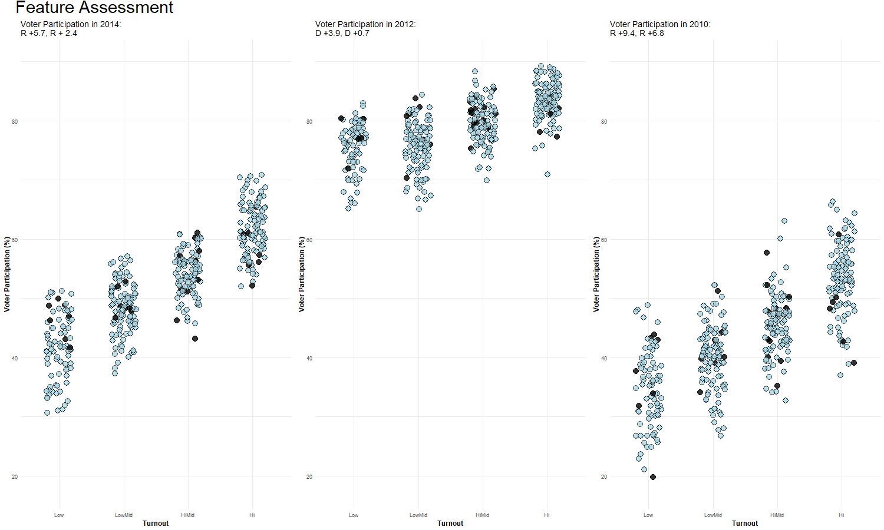

Slide 16
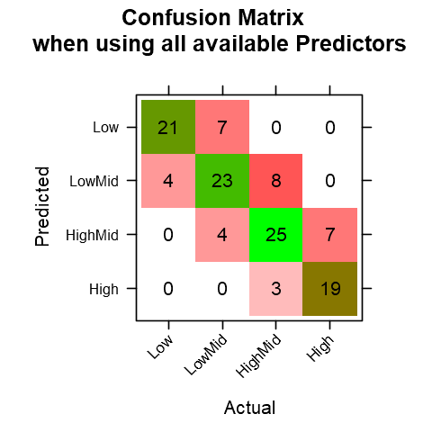
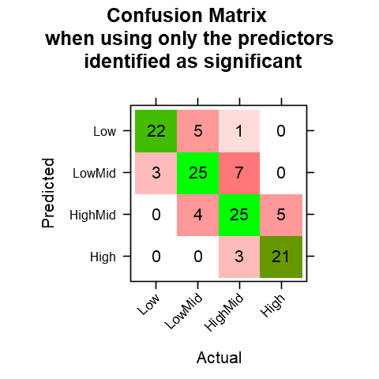
Ordinal Logit
Used Cumulative Link Model (clm) - library(ordinal)
Significant Variables identified
Voter_Participation_2014
White_Population_2016
Public_Nutrition_Assistance_2016
Home_Ownership_2016
Accuracy: All variables = 72.7%,
Only significant variables = 76.9%

Slide 17
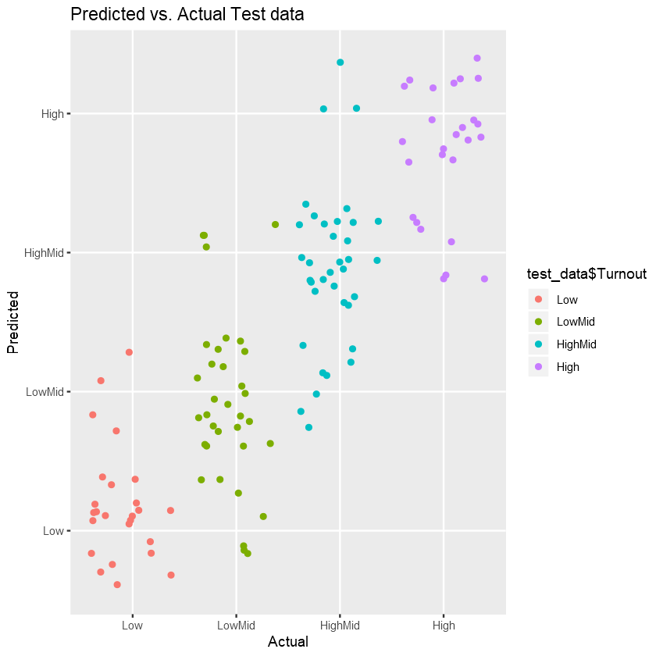
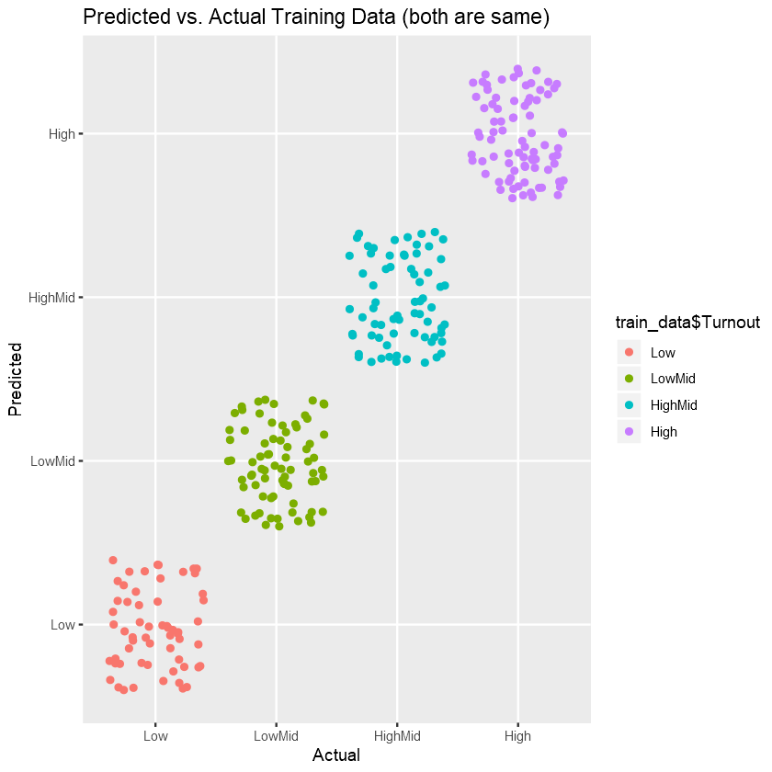
Ordinal Logit

Slide 18
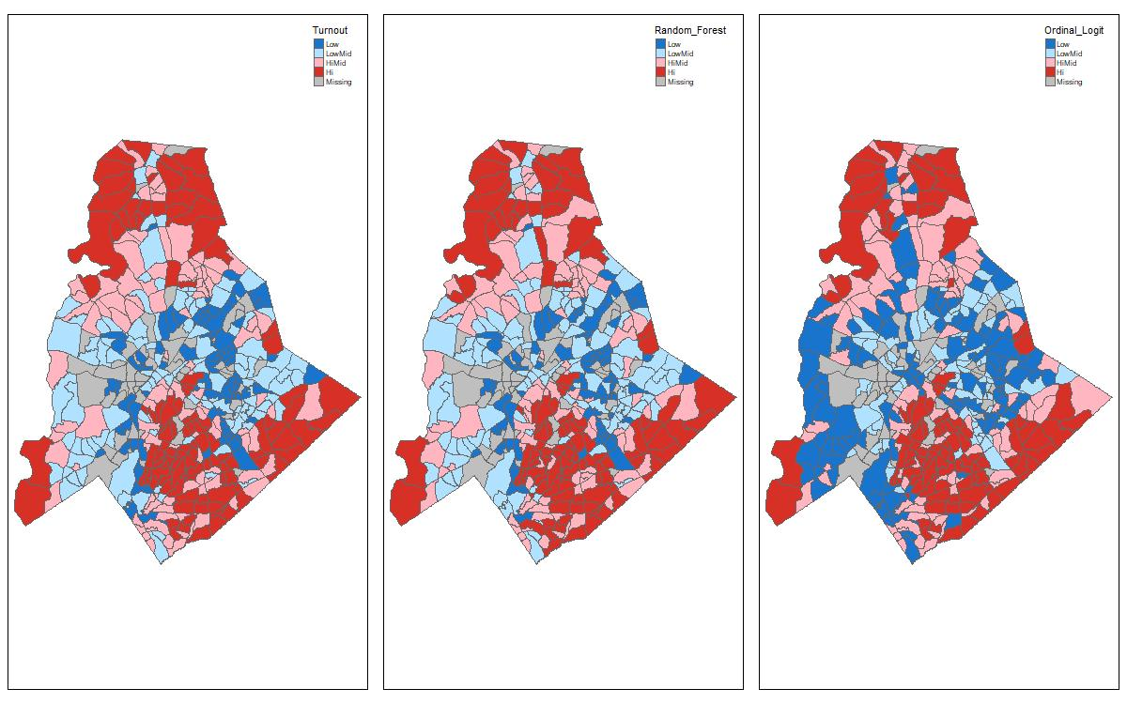
Geospatial Insights

Slide 19
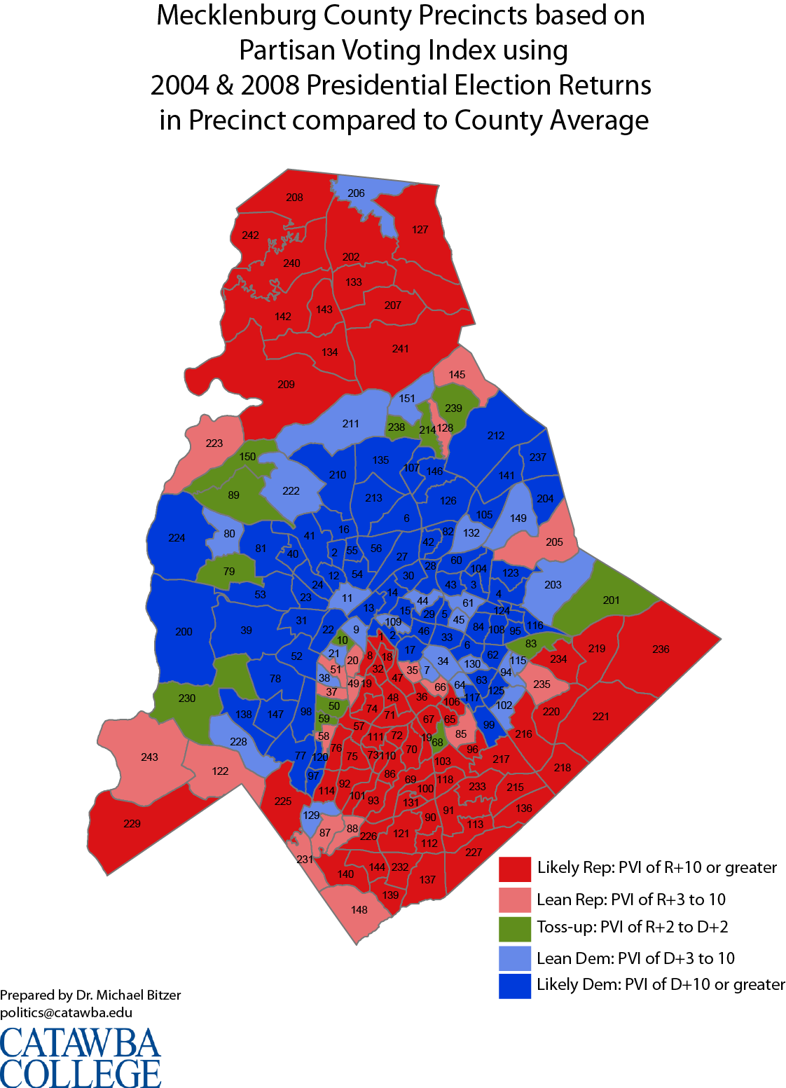
Future Changes
Utilize information for predictive analysis
Expand on data utilized
Incorporate other sources for political forecasting
Voter registration data
Polling data
Assessing political effects on voter participation

Slide 20
Questions?

